Slide 1
THE
SAFE SYSTEM
APPROACH
Zero is our goal. A Safe System is how we get there.

Slide 2
Note to presenters
This train-the-trainer presentation was developed with FHWA perspective for FHWA staff to provide an overview of the Safe System Approach.
Others are welcome to use it in whole or in part as appropriate to their purposes.
Thank you.

Slide 3
Imagine our country as a place where nobody has to die from vehicle crashes.
3
Source: Fehr & Peers
Notes:
Key Message: Before we get started, let’s take a moment to reflect on the reason we are here today: each day, people are killed and seriously injured on our roads. Crashes can irreversibly change the course of human lives, touching victims, their families and loved ones, and society as a whole. But death and serious injury do not have to be consequences we live with simply to use our roadway system. Through collective action on the part of all roadway system stakeholders—from system managers and vehicle manufacturers, to law enforcement and everyday users—we can move to a Safe System approach that first anticipates human mistakes and second keeps impact energy on the human body at tolerable levels—with the goal of eliminating fatal & serious injuries for all road users. This presentation gives an overview of the Safe System approach, as outlined on the next slide.
Interactivity: Ask the audience how familiar they are with the Safe System approach. What Safe System practices are they implementing or planning to implement in their communities?
Background: The Safe System approach is a global movement that has been in place in countries across the globe for more than 30 years. The Federal Highway Administration’s (FHWA) top priority is safety, and for this reason it fully supports the vision of zero deaths and serious injuries on the Nation’s roadway system. While the Safe System approach is new to the United States, it is worth mentioning that the majority of the States have adopted a zero deaths approach (also known as Toward Zero Deaths (TZD)), and more than 50 communities across the United States have adopted Vision Zero initiatives that set a goal of eliminating fatal and serious injuries from the roadway system. TZD and Vision Zero provide opportunities to adopt Safe System, and some States and localities have already adopted the Safe System approach.
Notes: Additional information on the FHWA Safe System approach is available at https://safety.fhwa.dot.gov/zerodeaths/

Slide 4
Presentation Overview
1
2
3
4
5
Introduction
Safe System Principles
Safe System Elements
Case Studies
Conclusion & Resources
4
Notes:
Key Message: The presentation begins with an overview of the current traffic safety problem and introduces the key concepts of the Safe System approach. The next sections provide additional information on the principles and elements that make up the Safe System approach. The presentation then shows examples of how components of the Safe System approach are already being applied in the United States. The presentation concludes with additional resources that you can use to help bring the Safe System approach to your community.
Interactivity: Before moving into Section 1 on the next slide, do any attendees have questions at this point?
Background: No background for this slide.
Notes: The presentation has 5 sections. Safe System Principles and Safe System Elements are the longest sections, and the presentation typically takes between 30 and 45 minutes.

Slide 5
Introduction
Assessment of our current situation and introduction to the Safe System approach
1
2
3
4
5
Introduction
Safe System Principles
Safe System Elements
Case Studies
Conclusion & Resources
5
Notes:
Key Message: This section provides an assessment of our current traffic safety situation and an introduction to the Safe System approach. The next slides present global and national trends in traffic fatalities.
Interactivity: No interactivity for this slide.
Background: This section provides data on traffic fatalities and shows that, nationally, traffic fatalities are staying relatively constant, while pedestrian deaths are increasing. The graphs that follow demonstrate that we as a nation are not making substantial progress on reducing the traffic deaths, and, in order to make meaningful reductions, we need to rethink how we approach safety. With this in mind, slides that follow introduce the Safe System approach. They begin with the general premise of the approach, which is to eliminate fatal and serious injuries for all road users by accommodating human mistakes and keeping impacts on the human body at tolerable levels. The presentation shows successful Safe System adopters from around the world before explaining how the Safe System approach is being implemented in the United States. The Safe System approach is an overall guiding vision. There are six Safe System principles, which are the fundamental tenets of a Safe System. Then there are the five Safe System elements, which are avenues for implementing a Safe System.
Notes: No notes for this slide.

Slide 6
Our Current Reality
Traffic fatalities are a public health crisis affecting all road users.
1.25M
36,835
6,283
Lives lost globally each year from traffic crashes
Source: World Resources Institute
Lives lost on US roads in 2018
Source: NHTSA
Pedestrians killed in US traffic crashes in 2018
Source: NHTSA
6
Notes:
Key Message: Traffic fatalities are a public health crisis affecting all road users, and it demands a concerted response. Each year, over a million lives are lost globally from traffic crashes. In 2018, an average of more than 100 people lost their lives on US roads, each day.
Interactivity: Ask attendees if they know what the fatality trends are in their communities.
Background: Data are from the World Resources Institute 2018 report Sustainable and Safe: A Vision and Guidance for Zero Road Deaths and the National Highway Traffic Safety Administration (NHTSA) Fatality Analysis Reporting System (FARS) database.
Notes: One way to customize this slide would be to add comparable fatality data for your local jurisdiction.

Slide 7
Behind the numbers
7
Notes:
This slide is left blank intentionally. It is intended for the presenter to add a personal story, or a story tailored to the audience/community-to help participants see the story behind the numbers.

Slide 8
Thousands of Lives are Lost Each Year
Total US Traffic Fatalities
2009-2018
8
Source: NHTSA
Notes:
Key Message: For the last three years, fatalities on US roads are the highest they’ve been in ten years. Preliminary data for 2019 show a decrease in fatalities to 36,096, which continues a downward trend but remains higher than any year before 2016. While this statistic is troubling, the trend in pedestrian fatalities, as shown on the next slide, is more alarming.
Interactivity: No interactivity for this slide.
Background: This slide shows the total police-reported US fatalities of motor vehicle traffic crashes, 2009-2018. This is the number of people who died, as opposed to the number of crashes, and it includes all motor vehicle occupants, motorcyclists, pedestrians, bicyclists, and people traveling by other modes. Data are from the NHTSA FARS database: https://www-fars.nhtsa.dot.gov/Main/index.aspx
Notes: No notes for this slide.

Slide 9
Pedestrian Deaths are increasing
Total US Pedestrian Fatalities
2009-2018
9
Source: NHTSA
Notes:
Key Message: In the past decade, the number of pedestrians struck and killed in motor vehicle crashes increased by more than 50%. Though fatalities decreased ever so slightly in 2017, the last year on record (2018) was the deadliest year for people killed by drivers while walking since 1990. These graphs demonstrate that we as a nation are not making substantial progress on reducing the traffic deaths, and, in order to make meaningful reductions, we need to rethink how we approach safety.
Interactivity: Ask the audience if they know and want to share traffic fatality and/or pedestrian fatality trends in their respective jurisdictions.
Background: This slide shows the total police-reported US pedestrian fatalities for 2009-2018. This is the number of people who died, as opposed to the number of crashes. Data are from the NHTSA FARS database: https://www-fars.nhtsa.dot.gov/Main/index.aspx
Notes: No notes for this slide.

Slide 10
How does the United States reach zero deaths?
10
Source: Fehr & Peers
Notes:
Key Message: Imagine in the coming decades that not a single person in the United States dies in a traffic crash. Thinking about safety this way requires a paradigm shift in how we perceive the problem. Rather than accepting fatalities and serious injuries as a price for mobility, the philosophy of the Safe System approach is grounded in an ethical imperative that no one should be killed or injured when using the roadway system. The following slides introduce the concept of the Safe System approach—how it’s been applied globally and how it’s being implemented in the United States.
Interactivity: No interactivity for this slide.
Notes: No notes for this slide.

Slide 11
A New Direction
The Safe System approach aims to eliminate fatal and serious injuries for all road users by:
Accommodating human mistakes
Keeping impacts on the human body at tolerable levels
11
Notes:
Key Message: The Safe System approach aims to eliminate fatal and serious injuries for all road users by accommodating human mistakes and keeping impacts on the human body at tolerable levels. This is the fundamental objective of the Safe System approach. What separates the Safe System approach from the traditional approach to safety is the ethical imperative that not even one death is acceptable in our roadway system. The next slide provides a bit of brief background on the Safe System approach.
Interactivity: No interactivity for this slide.
Background: No background for this slide.
Notes: Examples of accommodating human mistakes include roadway design features like rumble strips, which alert a driver when they are unintentionally departing the roadway, or vehicle design features like autonomous emergency braking, which activate to stop the vehicle when the driver may not be able to do so. Examples of keeping impacts on the human body at tolerable levels include measures to control speed, physically separating users travelling at different speeds (e.g. drivers and people riding bikes), and vehicle safety features like seatbelts and airbags.

Slide 12
Successful Safe System Adopters
Sweden
Vision Zero
60-70% Reduction in fatalities 1994-2015
Netherlands
Sustainable Safety
50-60% Reduction in fatalities 1994-2015
Australia
Safe System
50-60% Reduction in fatalities 1994-2015
New Zealand
Safer Journeys
50-60% Reduction in fatalities 1994-2015
Source: World Resources Institute
12
Notes:
Key Message: The Safe System approach is not a new concept. It has existed for more than 30 years in countries across the globe. Each of the early adopters of the Safe System approach, shown on this slide, has seen marked decreases in traffic fatalities across their roadway systems—each with at least a 50% reduction in fatalities. During the same period, fatalities in the US were only reduced by 11%. The Safe System approach is how these countries moved off the “plateau” of safety to start achieving significant reductions. These examples show promise that, by implementing a Safe System approach in the United States, we may be able to achieve meaningful reductions in traffic deaths. Indeed, the US has started implementing a Safe System through various initiatives, which we’ll discuss on the following slide.
Interactivity: No interactivity for this slide.
Background: Data are from the World Resources Institute 2018 report Sustainable and Safe: A Vision and Guidance for Zero Road Deaths: https://www.wri.org/publication/sustainable-and-safe-vision-and-guidance-zero-road-deaths
Notes: Countries that have adopted a Safe System approach have both the lowest rates of fatalities per 100,000 inhabitants and the fastest rate of change in fatality levels.

Slide 13
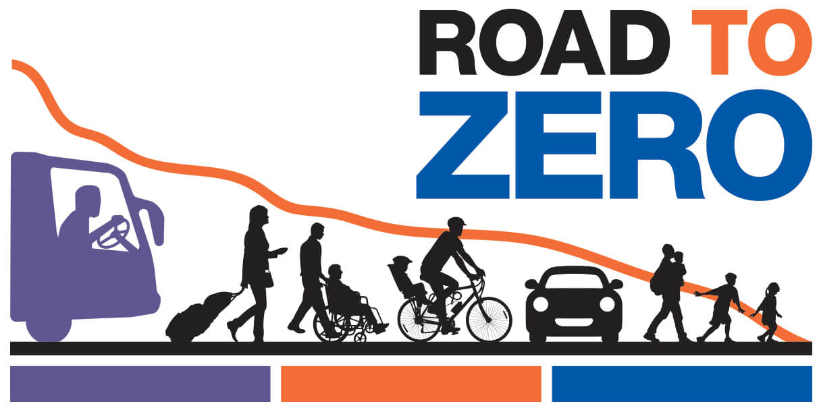
Safe System In the UNITED STATES
13
Notes:
Key Message: The Safe system Approach is newer in the United States, but efforts are underway to implement it more fully into our safety programs, and coordinate more closely with our partners. Several initiatives are already advancing the concept of a Safe System approach. While the names differ, the efforts are aligned around a vision of eliminating deaths and serious injuries from our roadway system. FHWA collaborates with these organizations -Road to Zero, Toward Zero Deaths, and Vision Zero Network- and fully supports the zero deaths goal. These initiatives offer ample opportunities to incorporate Safe System at the national, state, and local levels. To date, a number of State and local communities have adopted zero deaths goals and are applying the Safe System approach to reach their goals.
The following slide shows the Safe System approach that these groups and FHWA are advancing in the United States.
Interactivity: Ask who from the audience has worked with any of these organizations.
Background:
In addition to partners like State DOTs, the American Association of State Highway and Transportation Officials (AASHTO), and the Institute of Transportation Engineers (ITE), Road to Zero, led by the National Safety Council (NSC), is an initiative to develop a coordinated approach to reaching zero deaths within the next 30 years. FHWA, the National Highway Traffic Safety Administration (NHTSA), and the Federal Motor Carrier Safety Administration (FMSCA), support the Road to Zero’s goals of: Double down on what works through proven, evidence-based strategies; Advance life-saving technology in vehicles and infrastructure, and; Prioritize safety by adopting a Safe Systems approach and creating a positive safety culture.
Toward Zero Deaths is the National Strategy on Highway Safety, an overarching vision to eliminate injuries and fatalities on America's roads. NHTSA, FMCSA, and FHWA provided technical support to a group of professional organizations with an active role in highway safety, led by AASHTO
Vision Zero Network collaborates with communities to reach the goal of Vision Zero while increasing safe, healthy, and equitable mobility. FHWA coordinates with the Vision Zero Network to provide assistance to these communities
Notes: No notes for this slide.

Slide 14
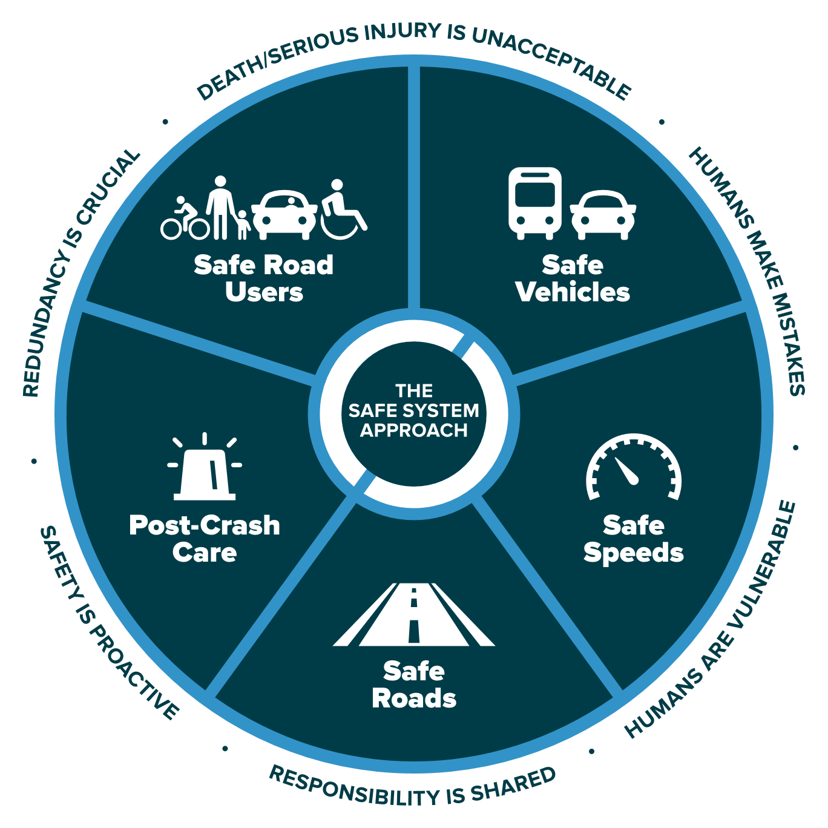
The Safe System Approach
Source: FHWA
14
Notes:
Key Message: This graphic presents an overview of the Safe System approach. There are three key components to understand, which will be explained on this and the following slides. These are the Safe System “approach,” “principles,” and “elements.” The Safe System “approach,” shown by the graphic on this slide, is the broadest term and describes all aspects of the Safe System.
In addition, the term “Safe System” is singular to depict an overall Safe Road System. The National Safety Council and our international partners also use this version.
Interactivity: No interactivity for this slide.
Background: This graphic was created for FHWA drawing inspiration from similar designs by the Institute of Transportation Engineers (ITE), the Road to Zero Coalition, and the Royal Society for the Prevention of Accidents (ROSPA) in the United Kingdom.
Notes: No notes for this slide.

Slide 15
The 6 Safe System Principles
Source: FHWA
15
Notes:
Key Message: The six Safe System “principles,” shown around the outside ring of the graphic, are the fundamental beliefs that the approach is built on. They establish the goal of the Safe System approach, acknowledge human limitations, and set expectations for how to act. A successful Safe System approach weaves together all six principles. The principles will be discussed in depth in the next section.
Interactivity: No interactivity for this slide.
Background: No background for this slide.
Notes: No notes for this slide.

Slide 16
The 5 Safe System Elements
Source: FHWA
16
Notes:
Key Message: The five Safe System “elements,” highlighted in the middle ring of the graphic, are conduits through which the Safe System approach must be implemented. The key focus of the Safe System approach is to reduce death and serious injuries through design that accommodates human mistakes and injury tolerances. Making a commitment to zero deaths means addressing every aspect of crash risks through the five elements of a Safe System. These layers of protection and shared responsibility promote a holistic approach to safety across the entire roadway system. The five elements will be discussed in depth later in the presentation.
Interactivity: No interactivity for this slide.
Background: No background for this slide.
Notes: No notes for this slide.

Slide 17
Safe System Principles
Overview of the 6 principles of the Safe System approach
1
2
3
4
5
Introduction
Safe System Principles
Safe System Elements
Case Studies
Conclusion & Resources
17
Notes:
Key Message: This section provides information on the six principles of the Safe System approach.
Interactivity: No interactivity for this slide.
Background: No background for this slide.
Notes: The six Safe System principles are: Death/Serious Injury is Unacceptable; Humans Make Mistakes; Humans Are Vulnerable; Responsibility is Shared; Safety is Proactive; and Redundancy is Crucial. They will be explained one-by-one on the following slides.

Slide 18
The 6 Safe System Principles
Death/serious injury is unacceptable
Humans make mistakes
Humans are vulnerable
Responsibility is shared
Safety is proactive
Redundancy is crucial
18
Notes:
Key Message: The six Safe System “principles” are the fundamental beliefs that the approach is built on. They establish the goal of the Safe System approach, acknowledge human limitations, and set expectations for how to act. They will be explained one-by-one on the following slides.
Interactivity: Ask whom in the audience recognizes any of these.
Background: These six principles are based on a framework developed by other Safe System adopters outside the United States, including Sweden, the Netherlands, Australia, and New Zealand.
Notes: No notes for this slide.

Slide 19
Death/serious injury is unacceptable
19
Source: Vision Zero Network
Notes:
Key Message: The first principle is that death and serious injury is unacceptable. While no crashes are desirable, the Safe System approach prioritizes crashes that result in death and serious injuries, since no one should experience either when using the roadway system. The goal is to modify how users, vehicles, transportation infrastructure, and emergency response operate to reduce the likelihood of crashes happening at all, and to reduce their severity when they do happen.
Interactivity: No interactivity for this slide.
Background: The image shows a memorial to people killed in traffic crashes.
Notes: This Toward Zero Deaths video is an option for speakers (note that it is 3:44 minutes long): https://youtu.be/_AIubBHtz7g

Slide 20
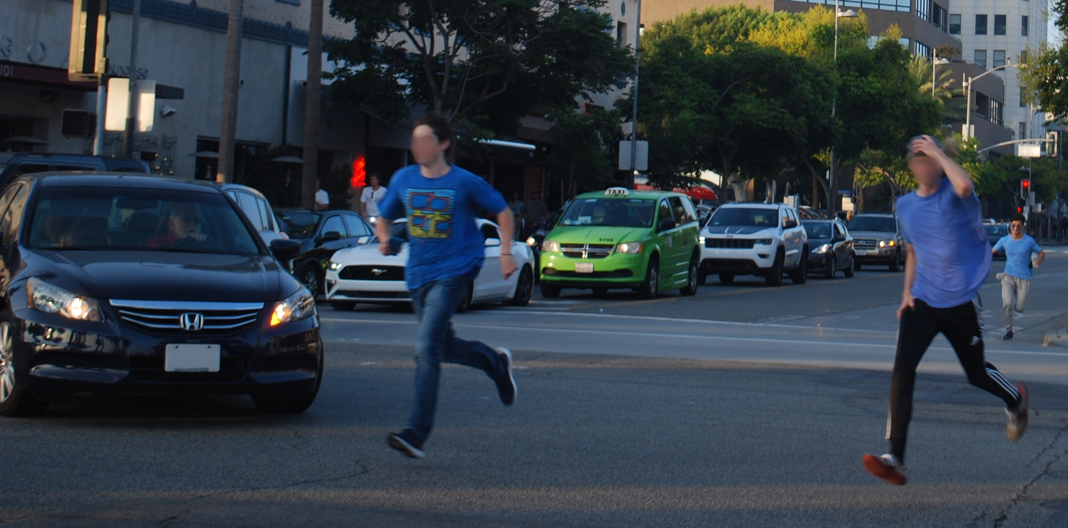
Humans make mistakes
20
Source: Fehr & Peers
Notes:
Key Message: The next principle is that humans make mistakes. People will inevitably make mistakes that can lead to crashes, but we can design and operate the roadway system to accommodate human mistakes to avoid death and serious injuries.
Interactivity: No interactivity for this slide.
Background: The image shows two people making a mistake by violating traffic rules and risking a collision.
Notes: An example of designing a roadway to accommodate human mistakes is adding a median to prevent errant drivers from entering oncoming traffic.

Slide 21
Humans are vulnerable
Fatality
100%
Fatality Risk
Serious Injury
0%
Crash Kinetic Energy
21
Source: FHWA
Notes:
Key Message: The next principle is that humans are vulnerable. As the chart shows, people have a limited ability to tolerate crash impacts before death and serious injuries occur. Human tolerance to crash impacts is central to the Safe System approach. The management of kinetic energy transfer to within survivable limits is important for understanding how to design and operate the road system consistently with the Safe System philosophy. The Safe System approach focuses not just on managing speed but managing transfer of kinetic energy.
Interactivity: No interactivity for this slide.
Background: The graphic was created for FHWA to explain the concept that as crash kinetic energy increases, so too does the potential of serious injury and death. It does not take particularly high kinetic energy levels for the potential of serious injury to occur.
Notes: No notes for this slide.

Slide 22
Responsibility is shared
System managers
Planners, designers, builders, operators, maintenance workers
Vehicle manufacturers
Law enforcement personnel
Post-crash personnel
System users
22
Notes:
Key Message: The next principle is that responsibility is shared. System managers, vehicle manufacturers, law enforcement, post-crash personnel, and system users all have a responsibility to promote safe behavior and ensure that crashes don’t lead to fatal or serious injuries.
Interactivity: No interactivity for this slide.
Background: No background for this slide.
Notes: Examples include system managers designing facilities with proven safety countermeasures, like roundabouts or median barriers; system managers keeping roadway systems in good state of repair; vehicle manufacturers applying the latest safety features in vehicles; law enforcement equitably enforcing traffic safety laws; and users of all travel modes safely moving through the roadway system. “System managers” includes planners, designers, builders, operators, and maintenance.

Slide 23
Safety is proactive
Identify risks
Mitigate risks
23
Notes:
Key Message: The next principle is that safety is proactive. In addition to crash-based analysis, transportation agencies should use proactive tools to identify and mitigate latent risks in the roadway system, rather than waiting for crashes to occur and reacting afterwards. This process, known as the Systemic Approach to Safety, uses crash history, roadway design, and other data to identify patterns in geometric design that lead to certain crash types. System designers then identify appropriate countermeasures to mitigate the crash types. These countermeasures are systemically applied at all locations meeting the particular geometric design, irrespective of crash history. Rather than managing risk at certain locations, a systemic approach takes a broader view and evaluates risk across an entire roadway system. A system-based approach acknowledges crashes alone are not always sufficient to determine what countermeasures to implement, particularly on low-volume local and rural roadways where crash densities are lower, and in many urban areas where there are conflicts between vehicles and vulnerable road users (pedestrians, bicyclists, and motorcyclists).
Interactivity: The speaker may want to facilitate a discussion among the audience: "I have limited funds. How can I justify addressing latent risks when I have other locations with a history of crashes? I don't have funding to do both.“
Background: No background for this slide.
Notes: Additional information on the Systemic Approach to Safety is available at https://safety.fhwa.dot.gov/systemic/

Slide 24
Redundancy is crucial
Safe road users
Safe vehicles
Safe speeds
Safe roads
Post-crash care
24
Notes:
Key Message: The final principle is that redundancy is critical. Reducing risks requires that all parts of the roadway system are strengthened, so that if one part fails, people are still protected. This is the last of the six Safe System principles. The next section will address the five Safe System elements.
Interactivity: Ask the audience if they have questions about the principles.
Background: No background for this slide.
Notes: An example of redundancy is rumble strips, which protect people when their own ability to be safe road users is compromised by distraction or drowsiness.

Slide 25
Safe System Elements
Overview of the 5 elements of the Safe System approach
1
2
3
4
5
Introduction
Safe System Principles
Safe System Elements
Case Studies
Conclusion & Resources
25
Notes:
Key Message: This section provides information on the five elements of the Safe System approach.
Interactivity: No interactivity for this slide.
Background: No background for this slide.
Notes: The five elements of the Safe System approach are: Safe Road Users, Safe Vehicles, Safe Speeds, Safe Roads, and Post-Crash Care. They will be explained one-by-one on the following slides.

Slide 26
The 5 Safe System Elements
Safe road users
Safe vehicles
Safe speeds
Safe roads
Post-crash care
26
Notes:
Key Message: The five Safe System “elements” are conduits through which the Safe System approach must be implemented. Making a commitment to zero deaths means addressing every aspect of crash risks through the five elements of a Safe System. These five elements will be explained one-by-one on the following slides.
Interactivity: No interactivity for this slide.
Background: These five elements are based on a framework developed by other Safe System adopters outside the United States, including Sweden, the Netherlands, Australia, and New Zealand.
Notes: The Safe System approach encompasses the elements of the 4Es (Enforcement, Education, Emergency Response, and Engineering). It refocuses efforts on reducing death and serious injury through accommodating human mistakes and reducing impact forces to tolerable levels.

Slide 27
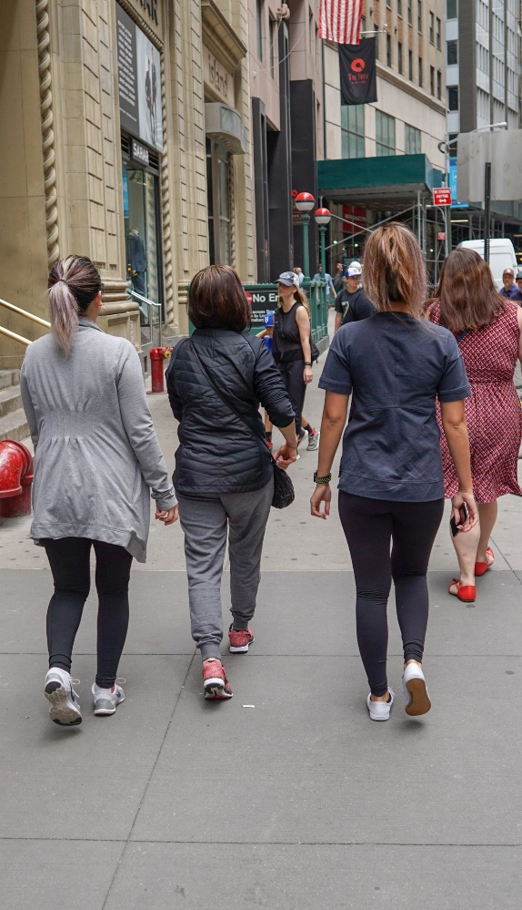
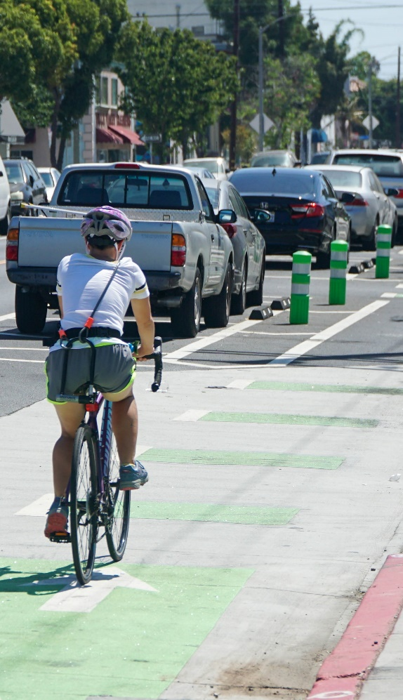
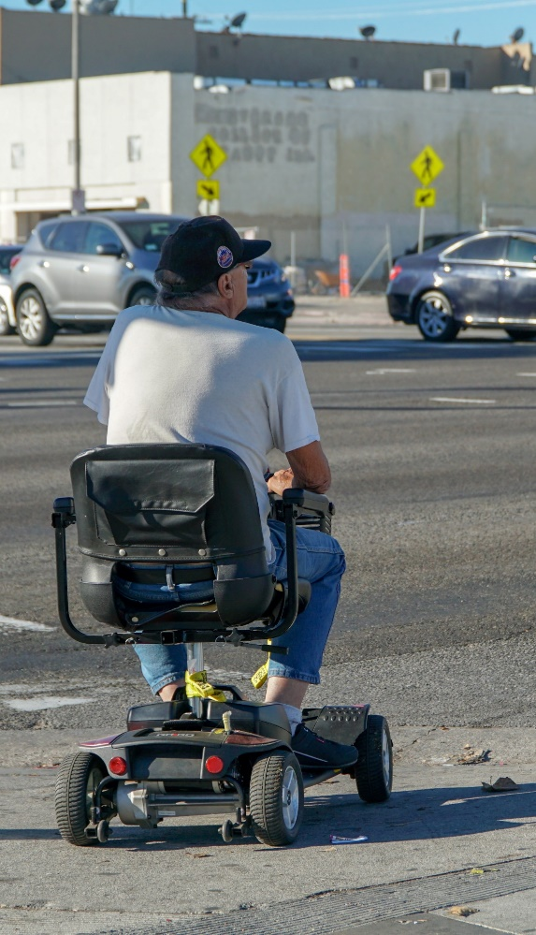
Safe Road Users
Walk
Bike
Drive
Transit
Other
27
Source for all images: Fehr & Peers
Notes:
Key Message: The first element is safe road users. The Safe System approach addresses the safety of all road users, including those who walk, bike, drive, ride transit, and travel by other modes. All road users are considered equal regardless of how they choose to travel. Each road user has a responsibility to operate, to the best of their ability, within the boundaries set by system managers, and education and enforcement can help to modulate user behavior.
Interactivity: No interactivity for this slide.
Background: The images show examples of the text below them.
Notes: An example of safe walking is starting to cross the street at a signalized intersection during the “walk” phase. An example of safe biking is riding with the direction of traffic. An example of safe driving is following signs and speed limits. An example of safe transit riding is not running for a transit vehicle. An example of safe travel by an “other” mode, such as a motorcycle, includes wearing proper protective equipment, or a wheelchair is obeying pedestrian traffic laws.

Slide 28
Safe Road Users – Continued
Not distracted or impaired
Follow rules
Act within the limits of the road design
28
Notes:
Key Message: We all make mistakes, but we all need to acknowledge the limits of our capabilities, so it is our responsibility to comply with the rules to ensure that we act within the limits of the road system’s design. System managers and law enforcement can use techniques like traffic or DUI enforcement, speed feedback signs, and education campaigns to promote compliance with rules.
Interactivity: Suggest asking participants provide examples for “act within limits of the road design”. Example may include slowing down at curves, walking against traffic where is no sidewalk available and must walk on the street.
Background: No background for this slide.
Notes: No notes for this slide.

Slide 29
Safe VEHICLES
Active safety
Passive safety
Measures to reduce the chance of a crash occurring
Lane departure warning
Autonomous emergency braking
Protective systems for when crashes do occur
Seatbelts and airbags
Crash-absorbing vehicle crumple zones
29
Notes:
Key Message: The next element is safe vehicles. Safe vehicles include “active” safety measures, to help prevent crashes from occurring, such as autonomous emergency braking; and “passive” safety measures, which protect occupants when a crash does occur, such as seatbelts and airbags. As described on the next slide, vehicle manufacturers are a key stakeholder in continuously evolving safety.
Interactivity: Ask the audience to name additional examples in each category.
Background: No background for this slide.
Notes: No notes for this slide.

Slide 30
Safe VEHICLES - continued
Other road user safety
New technology
Measures that protect other road users
Bicyclist and pedestrian detection
Vehicle size and design
Leveraging connected and automated vehicle (CAV) technology to improve safety
30
Notes:
Key Message: Safe vehicles must account for safety of other road users through elements such as size, design, and materials. Thinking ahead to the near future, elements such as bicyclist and pedestrian detection on connected vehicles (CVs) and automated vehicles (AVs) will be necessary to ensure vehicles are safe for all road users in the future.
Interactivity: Recommend some interactivity/discussion on vehicle size and design; are small vehicles safer? What designs are we referring to that make cars safer?
Background: No background for this slide.
Notes: No notes for this slide.

Slide 31
Safe Speeds
Speed is at the heart of a forgiving road transport system. It transcends all aspects of safety: without speed there can be no movement, but with speed comes kinetic energy and with kinetic energy and human error come crashes, injuries, and even deaths.”
Organisation for Economic Co-operation and Development
31
Notes:
Key Message: The next element is safe speeds. As the quote on the screen shows, there is a direct linkage between safe speeds and our ability to survive a crash. Put simply, humans are unlikely to survive high-speed crashes. Adjusting speeds can accommodate human injury tolerances in three ways: reducing impact forces, providing additional time for drivers to stop, and improving visibility.
Interactivity: No interactivity for this slide.
Background: This quote is from the Organisation for Economic Co-operation and Development (OECD) International Transport Forum (ITF) 2016 report Zero Road Deaths and Serious Injuries: Leading a Paradigm Shift to a Safe System: http://www.towardszerofoundation.org/wp-content/uploads/2016/10/Zero_road_deaths-SafeSystems.pdf
Notes: The International Transport Forum is an intergovernmental organization with 57 member countries. It acts as a think tank for transport policy and organizes the Annual Summit of transport ministers. ITF is the only global body that covers all transport modes. The ITF is politically autonomous and administratively integrated with the OECD. It is based in Paris, France.

Slide 32
SAFE SPEEDS: reducing Pedestrian fatalities
Hit by a vehicle traveling at
23 MPH
10% risk of death
Hit by a vehicle traveling at
42 MPH
50% risk of death
Hit by a vehicle traveling at
58 MPH
90% risk of death
32
Source: FHWA
Notes:
Key Message: There is a direct relationship between the speed at which a vehicle is traveling and the likelihood of survival for the person being hit. 9 out of 10 pedestrians are likely to survive if hit by a vehicle traveling around 20 MPH, while only 1 in 10 pedestrians will likely survive an impact at around 60 MPH.
Interactivity: No interactivity for this slide.
Background: This graphic was adapted for FHWA from a similar graphic in the USDOT Pedestrian Safety Action Plan: https://highways.dot.gov/sites/fhwa.dot.gov/files/2020-11/FHWA_PedSafety_ActionPlan_Nov2020.pdf. The USDOT graphic is based on data from the AAA Foundation for Traffic Safety’s 2011 report Impact Speed and a Pedestrian’s Risk of Severe Injury or Death: https://aaafoundation.org/wp-content/uploads/2018/02/2011PedestrianRiskVsSpeedReport.pdf
Notes: No notes for this slide.

Slide 33
Safe Speeds: Fatality Risks
100%
Fatality
Risk
0%
10
20
30
40
50
60
70
Impact Speed (MPH)
33
Source: FHWA
Notes:
Key Message: As we saw on the last slide, the human body is vulnerable and unlikely to survive an uncushioned impact at a speed of more than about 20 mph. Even relatively low speeds can kill or seriously injure unless the vehicle and the road environment take account of the physical vulnerability of all road users.
Interactivity: No interactivity for this slide.
Background: This graphic was adapted for FHWA from a similar graphic created by the Australian Roads and Traffic Authority of New South Wales: https://nacto.org/wp-content/uploads/2016/04/4-1_NSW-Roads-Traffic-Authority-Safe-Systems-Approach_2011.pdf. Please note this graph has been converted from the metric system to the English system.
Notes: The further to the left that the curve is on the graph, the lower the speed at which death occurs.

Slide 34
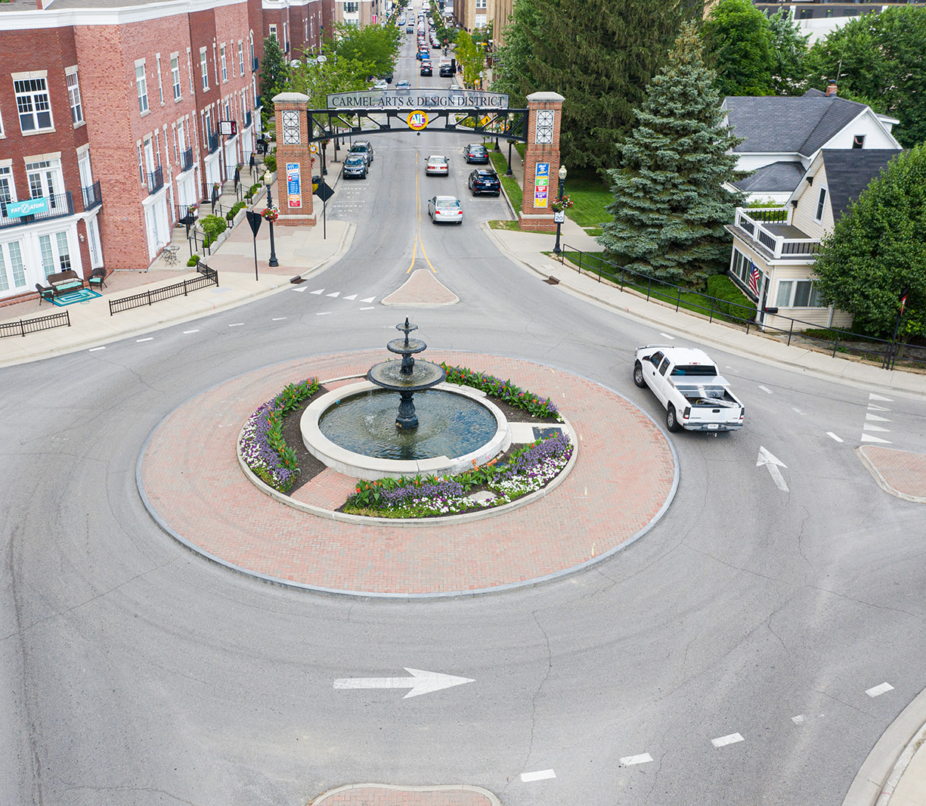
Safe SPEED: Treatments that Minimize Injuries
Speed through typical intersection
Speed through Safe System intersection
34
Source: Fehr & Peers
Source: City of Carmel, IN
Notes:
Key Message: This example shows that applying a Safe System treatment can reduce kinetic energy and the impact speed of a crash, which can help to minimize injuries.
Animation 1: The left side of the slide shows a typical intersection, where the design of the intersection does not necessarily limit the driver’s speed
Animation 2: The right side of the slide shows an intersection with a Safe System geometric design. The driver must slow their speed as they proceed around the roundabout
Speed limits help reduce speeds, too, but only when they are set with a context in mind. As an example, some Vision Zero cities set speed limits at 20 mph for urban areas with high pedestrian and bike activity.
Interactivity: This slide has 2 animations that require the speaker to click through each one at a time.
Background: Studies support the finding that even a small change in vehicle operating speed can have large safety impacts. According to NHTSA Countermeasures that Work, “a reduction of 3 mph in average operating speed on a road with a baseline average operating speed of 30 mph is expected to produce a reduction of 27% in injury crashes and 49% in fatal crashes.”
Notes: We will discuss the systemic deployment of roundabouts as a case study later in the presentation.

Slide 35
Safe ROADS
Safe roads are designed and operated to:
Prevent crashes
Keep impacts on the human body at tolerable levels
35
Notes:
Key Message: The next element is safe roads. Safe roads are designed and operated to prevent crashes and keep impacts on the human body at tolerable levels. As the following two slides show, we can keep impacts at tolerable levels by avoiding crashes altogether and by managing crash kinetic energy.
Interactivity: No interactivity for this slide.
Background: No background for this slide.
Notes: This slide introduces the objective of Safe Roads. The specifics are detailed on the following slides.

Slide 36
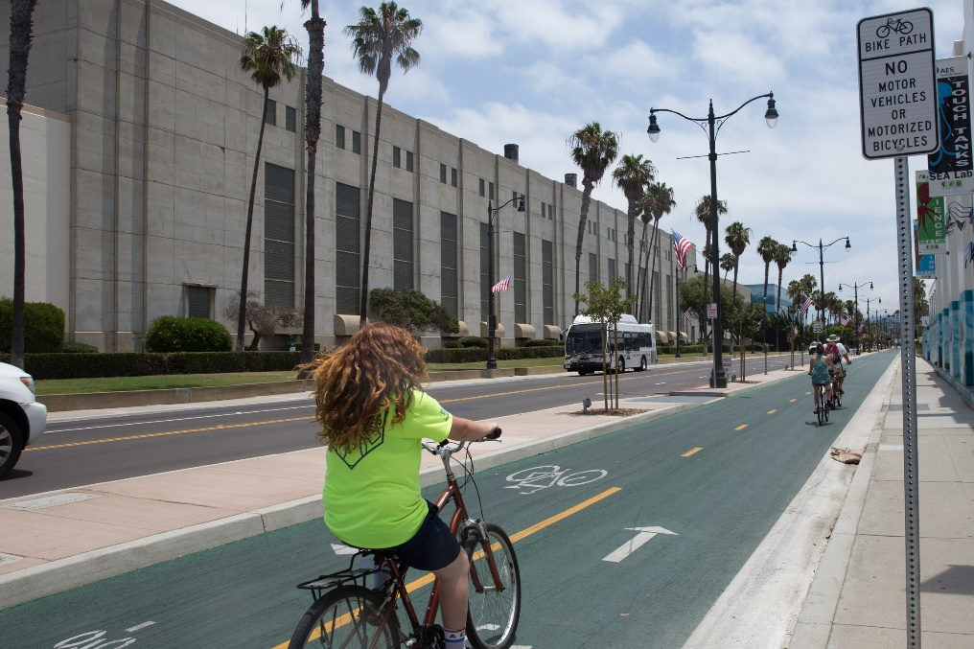
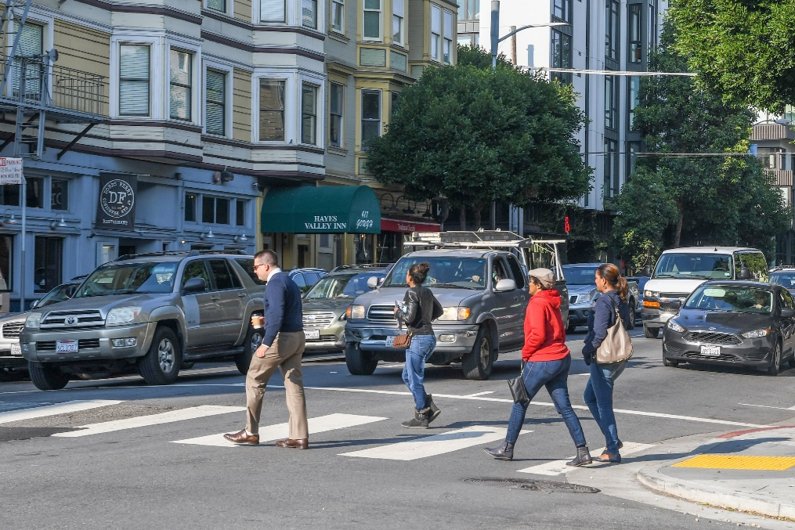
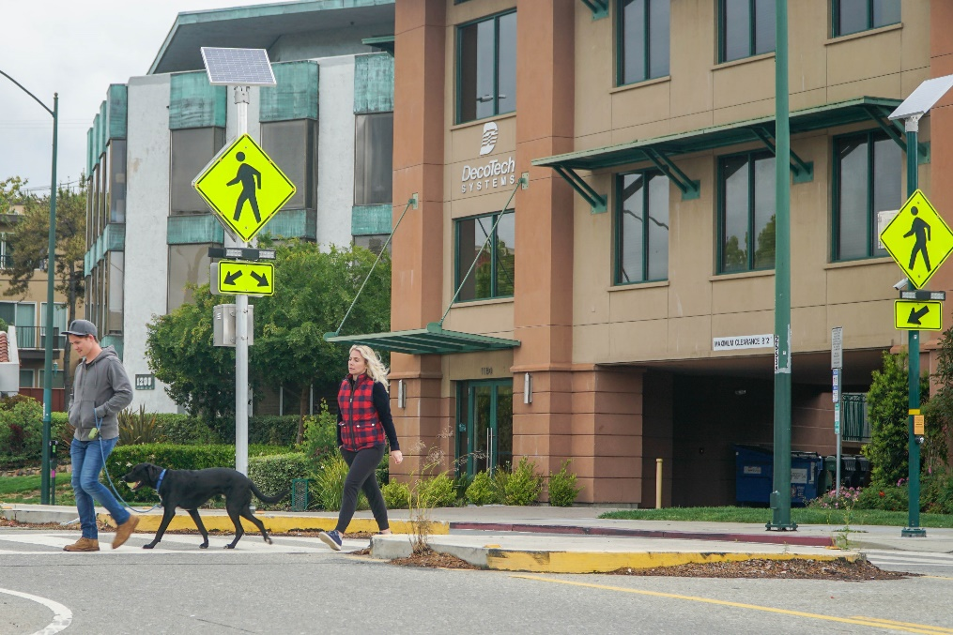
Safe ROADS: AVOIDING CRASHES
Avoiding crashes involves:
Separating users in space
Separating users in time
Increasing attentiveness and awareness
36
Source for all images: Fehr & Peers
Notes:
Key Message: Avoiding crashes involves:
Separating users in space – This approach segregates the physical space to provide travelers with a dedicated part of the right-of-way. Typically, travelers moving at different speeds – pedestrians, bicyclists, etc. (e.g. sidewalks, cycle tracks, pedestrian overpasses) – or different directions (e.g. turning vehicles in separate turn lanes) are separated in space to minimize conflicts with other users.
Separating users in time – This approach assumes that users will need to occupy the same physical space on the roadway, but creates a safer environment by separating the users in time and reducing vehicle interactions with vulnerable road users. An example is a pedestrian scramble phase at an intersection whereby pedestrians have exclusive access to the intersection while all vehicle movements are stopped.
Increasing attentiveness and awareness – This approach seeks to alert users to potential hazards and/or the presence of other users. These techniques can be vehicle, user or infrastructure-based, such as:
“Daylighting” intersections by removing parking at the corners to allow greater visibility between drivers and pedestrians.
Street lighting that increases nighttime visibility of users.
Rumble strips that alert inattentive or drowsy drivers that they are leaving their lanes.
Rectangular rapid flashing beacons that warn drivers of the presence of crossing pedestrians.
Interactivity: No interactivity for this slide.
Background: The images show examples of the text below them. At left, a street with clear physical separation for different users; in the center, users who are clearly separated by time while they cross the street; and at right, a rectangular rapid flashing beacon, which draws attention to the crossing pedestrians.
Notes: Sometimes a combination of multiple techniques is used, such as a protected left turn bay where the turning vehicles are physically separated while awaiting the opportunity to turn and separated in time with a protected left turn signal phase.

Slide 37
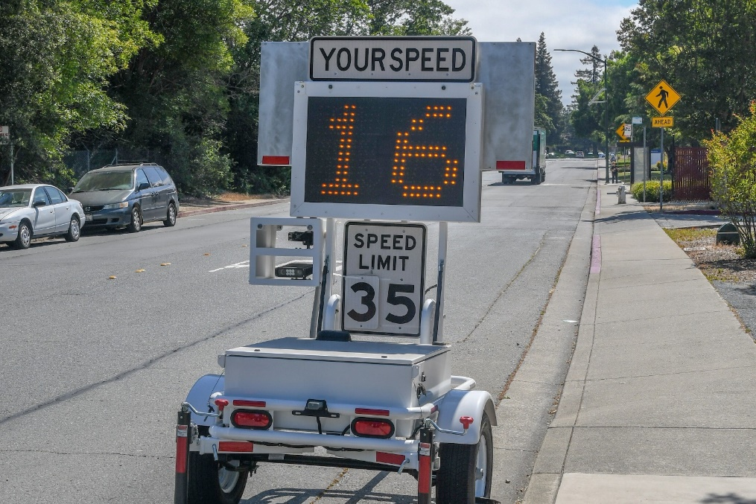
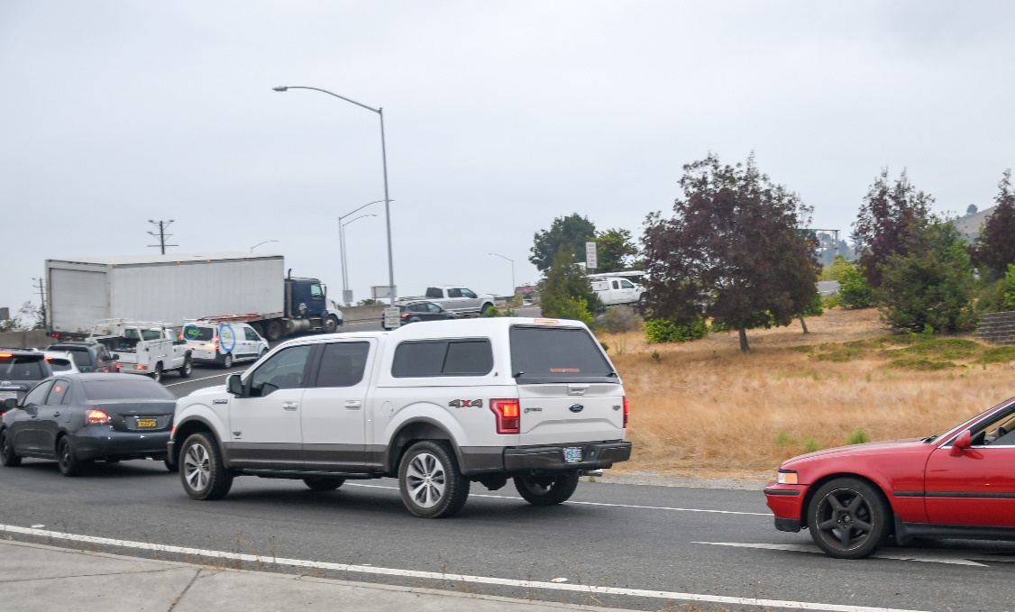
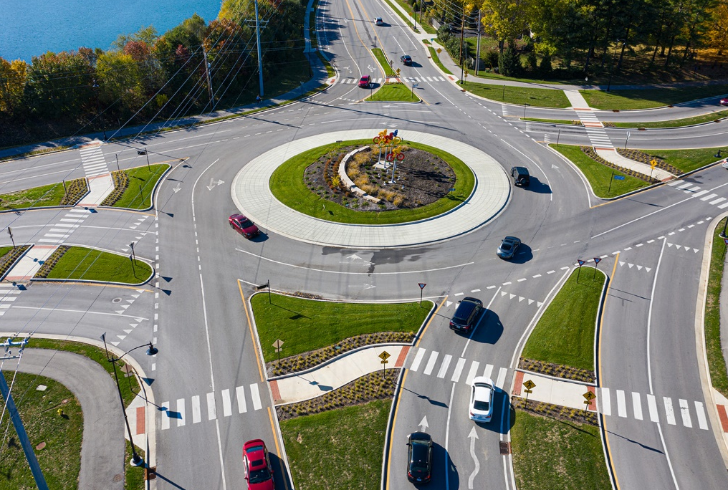
Safe ROADS: Crash Kinetic Energy
Managing crash kinetic energy involves:
Managing speed
Manipulating mass
Manipulating crash angles
37
Source: Fehr & Peers
Source: Fehr & Peers
Source: City of Carmel, IN
Notes:
Key Message: Managing crash kinetic energy to within human tolerance levels can be achieved by:
Managing speeds – context sensitive speed limits; for example: setting lower speed limit in areas with more pedestrian traffic
Manipulating mass – size and design of vehicles; for example: SUV vs. small sedan
Manipulating crash angles – road design that eliminates right angle crashes; for example: roundabouts
All of them play a critical role in producing impact forces to human bodies
Interactivity: The speaker may want to ask the audience to identify additional examples that demonstrate individual or combined strategies.
Background: The images show examples of the text below them. At left, a speed feedback trailer for speed management; in the center, collision absorbance devices; and at right, a roundabout, which reduces speeds and collision angles to limit impact forces.
Notes: No notes for this slide.

Slide 38
Safe ROADS: ALL ASPECTS OF THE ROADWAY SYSTEM
Safe roads include all aspects of the roadway system:
Design
Construction
Maintenance
Operation
38
Notes:
Key Message: Safe roads include all aspects of the road system. Each has a role in accommodating human mistakes and injury tolerances to reduce the severity of crashes that do occur.
Interactivity: No interactivity for this slide.
Background: No background for this slide.
Notes: No notes for this slide.

Slide 39
Post-Crash Care
Vital post-crash actions include:
First responders
Medical care
Crash investigation
Traffic incident management
Justice
39
Notes:
Key Message: The final element is post-crash care.
When a person is injured in a crash, they rely on emergency first responders to quickly locate them, stabilize their injury, and transport them to medical facilities.
The post-crash care in a Safe System extends beyond emergency services. Quick-response and investigation by police and road managers can help ensure crash factors are documented and reported correctly, clear traffic incidents so that traffic flow may be restored as safely and quickly as possible, the justice system can take appropriate action, and the risk of future crashes can be mitigated through an appropriate design and program or policy changes. These help inform our safety programs.
Crash reporting practices, such as complete data collection and documentation of road user behavior and infrastructure, and sharing data across agencies or organizations (e.g., among police departments, transportation officials, and hospitals) can help lead to a greater understanding of the holistic safety landscape, and thus lead to improved investments in safety.
Interactivity: No interactivity for this slide.
Background: No background for this slide.
Notes: The World Health Organization’s 2016 Post-Crash Response report provides additional guidance on post-crash care: https://www.who.int/violence_injury_prevention/publications/road_traffic/Post-crash_response_booklet.pdf

Slide 40
the 5 Safe System Elements Create Redundancy
The “Swiss Cheese Model” of redundancy creates layers of protection
Death and serious injuries only happen when all layers fail
Safe road users
Safe road users
Safe vehicles
Safe vehicles
Safe speeds
Safe speeds
Safe roads
Safe roads
Post-crash care
Post-crash care
40
Source: FHWA
Notes:
Key Message:
The left graphic shows how five Safe System elements work together, such that if one part fails, there are redundant systems in place. The “Swiss Cheese Model” helps demonstrate this redundancy. Layered safety measures are represented as slices of swiss cheese with the holes being weaknesses in individual parts of the system. The holes represent weakness causing failures or latent condition. When the cheese slices act as successive layers of defenses and the holes are not lined up, a person is protected.
The right graphic shows that a failure only results when a hole in each slice momentarily aligns, permitting a hazard to pass through holes in all the slices. The basic principle is that lapses and weaknesses in one part of the system can occur, but other parts compensate to not allow a failure. This relates back to the Safe System principles that redundancy is critical and responsibility is shared.
We’ve now discussed all six Safe System principles and all five Safe System elements. The next section of the presentation focuses on Safe System case studies.
Interactivity: Optional break for questions.
Background:
The “Swiss Cheese Model” is applicable to numerous risk management fields and was originally espoused by Dante Orlandella and James T. Reason of the University of Manchester. The graphic was adapted for FHWA from their work to explain the redundancy of the five Safe System elements.
We showed the previous slide where all the holes are lined up, meaning redundancy isn’t there. This slide shows cheese slices with the holes not lined up and how redundancy works.
Notes: A good example of how the five Safe System elements work together to create redundancy is distracted driving. Education campaigns focused on alert driving—avoiding behaviors like texting while driving—help create safe road users. Vehicle safety systems, like lane departure warnings, create safe vehicles that alert distracted drivers to potential hazards. Enforcement can help maintain safe speeds, so that if an incident should occur due to distracted driving, impact forces on the human body remain within tolerable levels. Infrastructure like rumble strips creates safe roads and an additional layer of redundancy to warn distracted drivers about a potential roadway departure. Sometimes, all these measures are not enough to prevent a distracted driving crash from occurring, but efficient, rapid post-crash care can help this mistake not be fatal.

Slide 41
Case Studies
Examples of the Safe System approach in the United States
1
2
3
4
5
Introduction
Safe System Principles
Safe System Elements
Case Studies
Conclusion & Resources
41
Notes:
Key Message: We will now look at two case studies that show how components of the Safe System approach have been implemented in cities large and small across the United States.
Interactivity: No interactivity for this slide.
Background: No background for this slide.
Notes: The two case studies are a citywide roundabout implementation in Carmel, IN and a systemic, multimodal safety project along Queens Blvd in New York, NY.

Slide 42
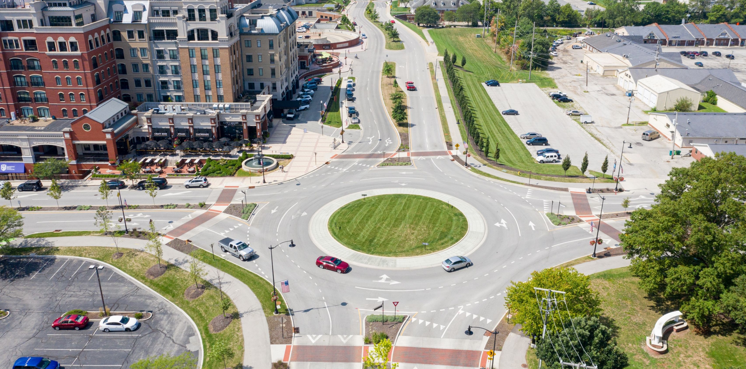
Roundabouts: Carmel, IN
Safe System Elements Covered
42
Source: City of Carmel, IN
Notes:
Key Message: Since 1997, Carmel, IN, has taken a Safe System approach to intersection design by installing roundabouts at intersections wherever possible. The city of Carmel took a systemic approach by converting over 125 intersections to roundabouts to improve safety citywide, regardless of crash history. Roundabouts move people through intersections more efficiently and safer than stop signs or signalized intersections. With roundabouts now at so many of the city’s intersections, Carmel has seen serious injury crashes reduced by about 80 percent, and the number of crashes overall has reduced by about 40 percent. The Mayor of Carmel instituted the comprehensive roundabout program to prioritize safety after learning from Europe that roundabouts eliminate right angle and head on crashes and reduce pedestrian conflict crashes. In addition, roundabouts slow the speed of vehicles maneuvering through an intersection, thus reducing the kinetic forces and crash severity if a crash occurs. In making these changes, designers addressed the Safe System elements of Safe Users, Safe Speeds, and Safe Roads.
Interactivity: Ask audience if their jurisdictions installed roundabouts and what the outcomes are.
Background: The image is an aerial view of one of Carmel’s roundabouts.
Notes: The City of Carmel maintains a website about its roundabouts, where additional information is available: https://www.carmel.in.gov/department-services/engineering/roundabouts

Slide 43
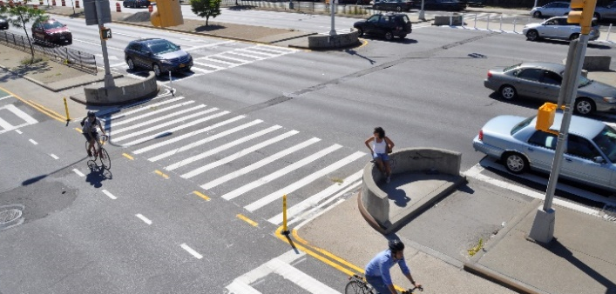
Queens Blvd: New York, NY
Safe System Elements Covered
43
Source: NYCDOT
Notes:
Key Message: New York City completed a systemic, data-driven crash analysis to understand where high concentrations of crashes are occurring. They used this information to develop a high-injury network (HIN), a concentration of streets where crashes are disproportionately happening. With the HIN in place, the City then set out to develop infrastructure countermeasures, such as those on Queens Boulevard, which included pedestrian improvements, bike lanes, and physical barriers to separate users in space. These additions increased the safety of crossing pedestrians, reduced speeds, and separated users in time. Traffic injuries dropped 35 percent on the 2.5-mile stretch of Queens Boulevard when dedicated space for walking and biking was added. Pedestrian injuries declined by 63 percent. In making these changes, designers addressed the Safe System elements of Safe Users, Safe Speeds, and Safe Roads. The information from crashes helped identify designs with risks so the countermeasures could be implemented at more than just the high-crash locations. Having described these two case studies, we will now move to the final section of the presentation.
Interactivity: No interactivity for this slide.
Background: The image shows Queens Blvd after project implementation, with clearly delineated spaces for multiple users.
Notes: More information about the Queens Blvd project is available on the New York City Department of Transportation’s project website: https://nycdotprojects.info/queens-blvd

Slide 44
Conclusion & Resources
Tools to bring the Safe System approach to your community
1
2
3
4
5
Introduction
Safe System Principles
Safe System Elements
Case Studies
Conclusion & Resources
44
Notes:
Key Message: This final section summarizes the key distinctions of the Safe System approach and provides tools to bring the approach to your community.
Interactivity: No interactivity for this slide.
Background: No background for this slide.
Notes: No notes for this slide.

Slide 45
Where are You on the Safe System Journey?
Traditional approach
Safe System approach
Prevent crashes
Prevent death and serious injuries
Improve human behavior
Design for human mistakes/limitations
Control speeding
Reduce system kinetic energy
Individuals are responsible
Share responsibility
React based on crash history
Proactively identify and address risks
45
Notes:
Key Message: As we’ll see in the text that appears on the slide, implementing the Safe System approach requires moving away from several traditional safety paradigms.
Animation 1: Rather than preventing crashes, the Safe System approach seeks to prevent death and serious injuries
Animation 2: In addition to trying to improve human behavior, the Safe System approach designs for human mistakes and limitations
Animation 3: While the traditional safety approach focuses on controlling speeding, the Safe System approach attempts to reduce system kinetic energy
Animation 4: Rather than asserting that only individuals are responsible, the Safe System approach aims to share responsibility among system users, managers, and others
Animation 5: Instead of reacting based on crash history, the Safe System approach proactively identifies and addresses risks
Implementing the Safe System approach is our shared responsibility, and we all have a role. The next slide introduces FHWA resources to help agencies implement the Safe System approach.
Interactivity: This slide has 5 animations that require the speaker to click through each one at a time.
Background: No background for this slide.
Notes: The Safe System approach encompasses the elements of the 4Es (Enforcement, Education, Emergency Response, and Engineering). It refocuses efforts on reducing death and serious injury through accommodating human mistakes and reducing impact forces to tolerable levels.

Slide 46
FHWA Resources
Safe System Materials
Find more resources at: safety.fhwa.dot.gov/zerodeaths
46
Notes:
Key Message: FHWA is developing resources to help agencies implement the Safe System approach. FHWA currently offers Safe System outreach materials including a brochure and video in addition to this presentation. The Safe System and HSIP Report illustrates commonalities between the Safe System approach, the Highway Safety Improvement Program (HSIP), and the Strategic Highway Safety Plan (SHSP), along with ways that a Safe System approach can be worked into how states apply these programs. The Safe System Intersection Assessment Framework is currently under development and will be shared as soon as it is available. In addition to these tools, the FHWA Zero Deaths website, linked on the slide, provides resources to learn about the Safe System approach. Beyond FHWA, the three initiatives mentioned earlier in the presentation—Road to Zero Coalition, Toward Zero Deaths, and Vision Zero Network—offer additional resources for agencies looking to bring a Safe System approach to their community.
Interactivity: No interactivity for this slide.
Background: No background for this slide.
Notes: No notes for this slide.

Slide 47
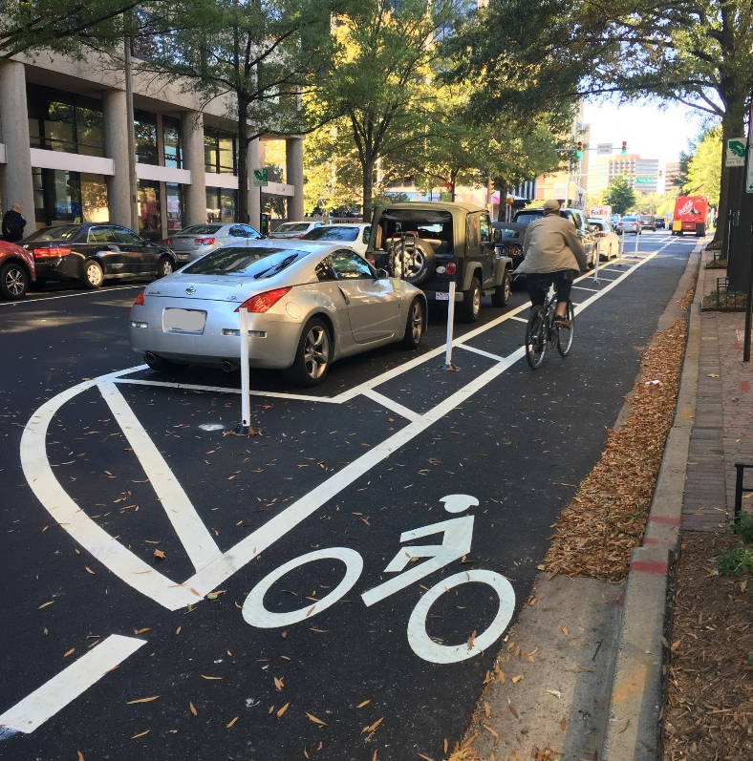
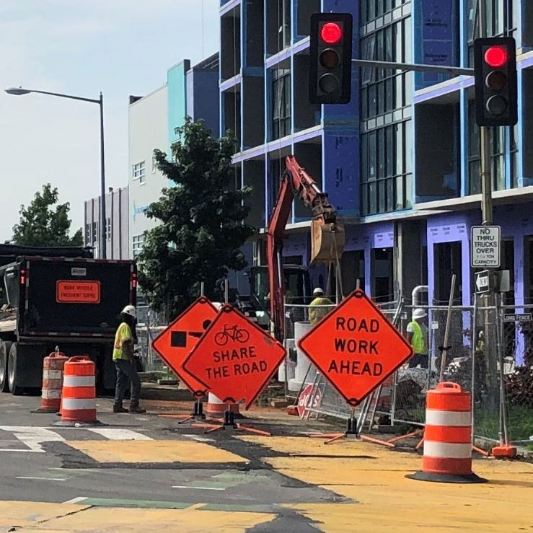
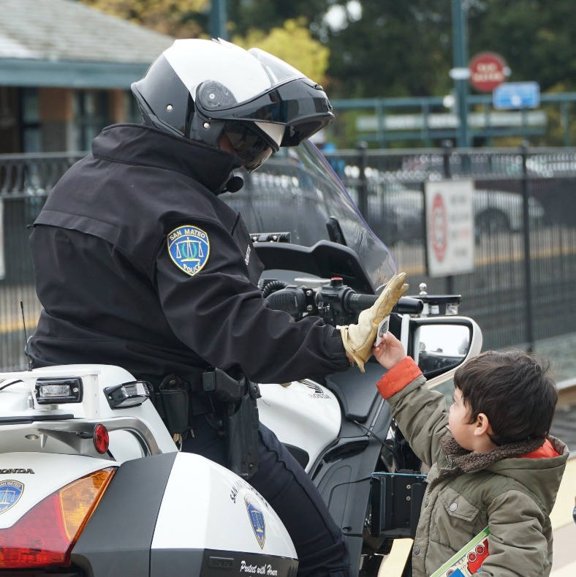
Implementing the Safe System approach is our shared responsibility, and we all have a role.
Source: Fehr & Peers
Source: Arlington County, VA
Source: Fehr & Peers
Source: Fehr & Peers
47
Notes:
Key Message: As we wrap up the presentation, it’s important to remember that road safety is truly a matter of life and death. To get the best result, zero deaths, we must integrate the safe system approach to our safety framework. We need to work together, and our system needs to work together, to get to zero. Achieving a future with zero traffic deaths requires a Safe System approach—shifting how we think about road safety and how we prioritize our investments. Consider applying a Safe System lens to upcoming projects and plans in your community: put safety at the forefront and design to accommodate human mistakes and injury tolerances. As transportation professionals, road safety is in our hands. We have the power to achieve a Nation where nobody has to die from vehicle crashes. At this point, we’ve reached the end of the presentation and can take any questions you have.
Interactivity: Consider what a Safe System approach means for your agency and areas of responsibility. What might a Safe System lens look like for an upcoming project or plan? How might a Safe System approach change your work? For example, more collaboration with operational safety agencies, EMS, public health, etc.
Background: No background for this slide.
Notes: No notes for this slide.

Slide 48
Zero is our goal.
A Safe System is how we get there.
Questions?
48

